Slide 1









PLATINUM SPONSOR
GOLD SPONSORS
SILVER SPONSOR
BRONZE SPONSOR
STRATEGIC PARTNER

Slide 2


Tune Your
TOMASZ GOŁASZEWSKI
tgolaszewsk3@dxc.com

Slide 3

About me
Data Architect in DXC Technology
Specialized in Business Intelligence (DWH, OLAP, Reporting)
MS SQL Server certified (MTA, MCP, MCSA, MCSE – BI, MCSE – DMaA)
Member and Speaker of Data Community
Member and Speaker of Power BI User Group
Tomasz
Gołaszewski

Slide 4
Primaries
PowerBI vs Analysis Services
How does PowerBI store data?
Do I really can improve anything?
Let’s practice!

Slide 5

PowerBI Storage

Slide 6
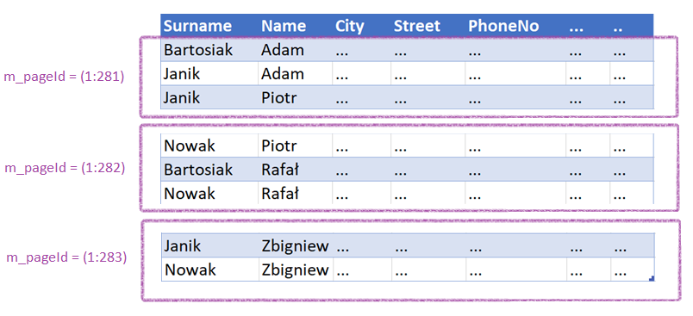
„Old-fashion” Row Storage

Slide 7
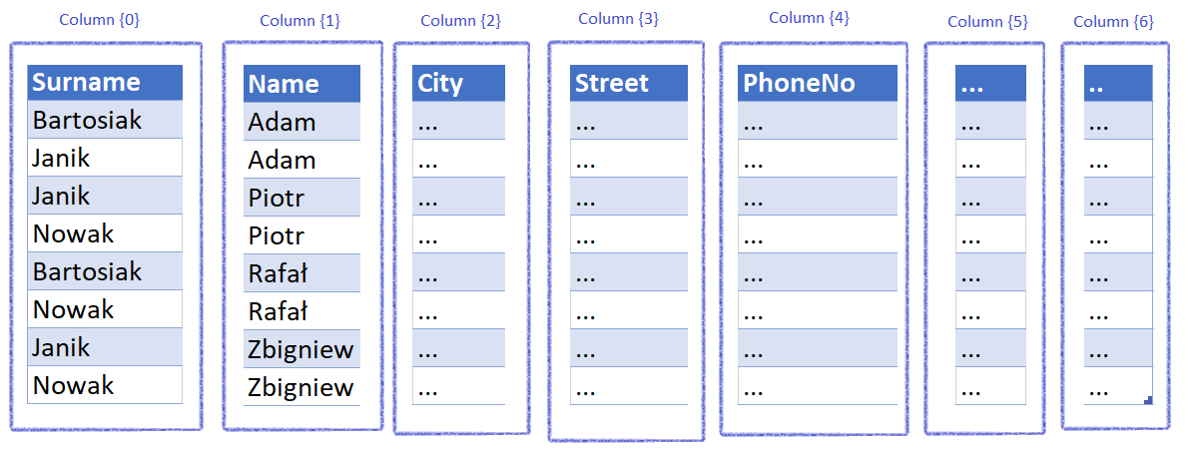
Column Storage

Slide 8
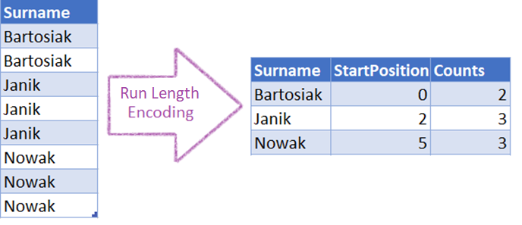
RLE

Slide 9
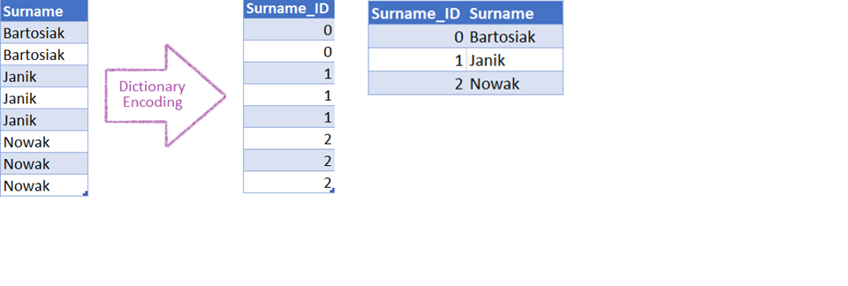
Dictionary + RLE

Slide 10
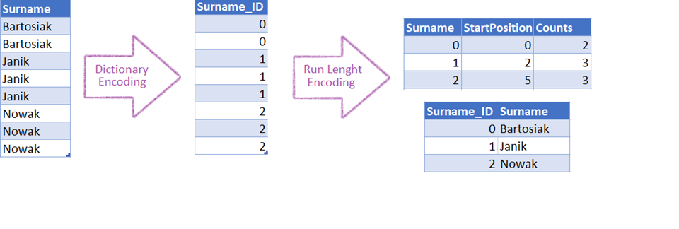
Dictionary + RLE

Slide 11
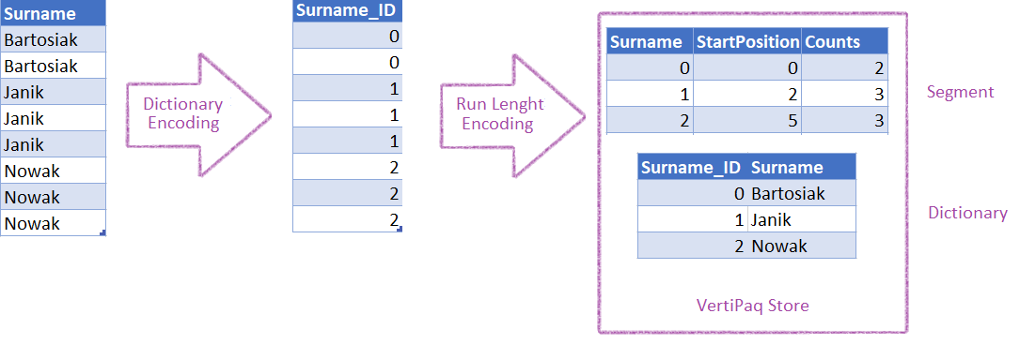
Dictionary + RLE

Slide 12
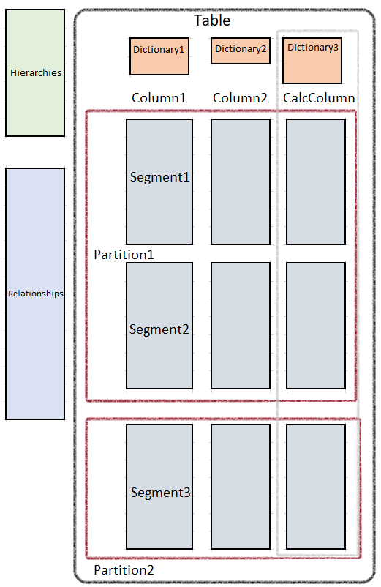

Slide 13
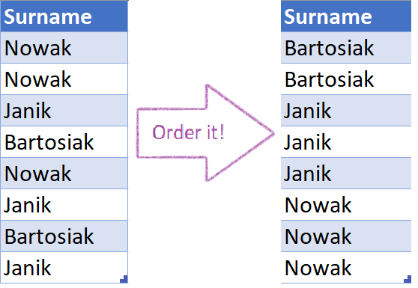
Importance of Order

Slide 14
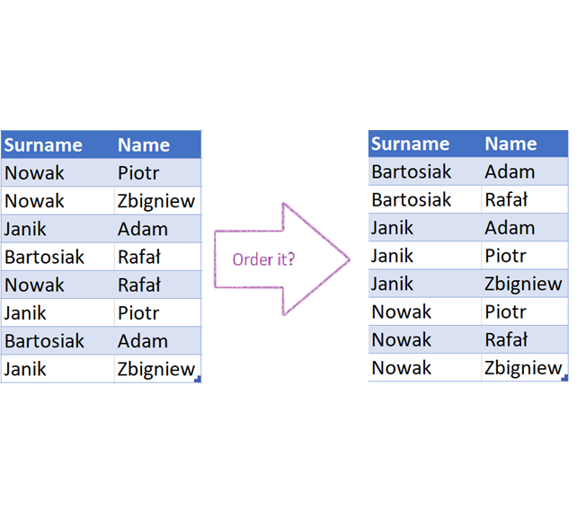
Importance of Order

Slide 15
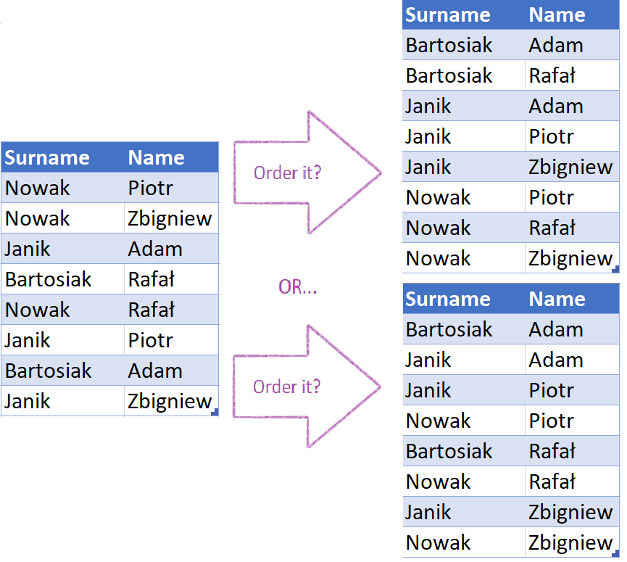
Importance of Order

Slide 16
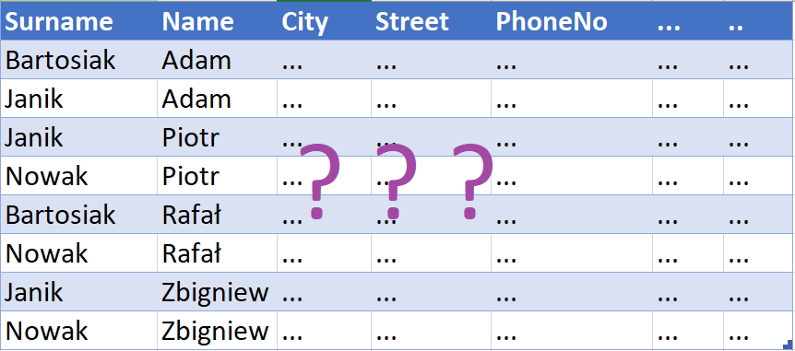
Importance of Order

Slide 17
GOTO DEMO;
DECLARE @Var1 INT;
SET @Var1 = (SELECT CASE WHEN MONTH(GETDATE()) <= 6 THEN 1 ELSE 0 END) ;
IF @Var1 = 0
BEGIN
END
DEMO:
PRINT ’Start our show!’;
GO

Slide 18
Performance tips
Remove all unnecessary tables
Remove all unnecessary columns
Avoid unique columns
Append multiple tables discribing the same attribute
Merge multiple tables describing the same dimension
Measure vs Calculated Columns

Slide 19
Performance tips
Play with visual interactions
Limit your report to see only needed data
Use Integers instead of String (but...)
Do you really need this precision?
DirectQuery vs Indexes
Did I mentioned about DAX?

Slide 20
Performance tips
Move calculated columns and measures to Data Source
Avoid relationships on calculated columns
Consider limitation of visuals
Check RLS when you test performace issues
225 seconds to error

Slide 21
Performance tips
Custom visuals
Data Gateway Enterprise Mode instead of Personal
Scale up / Scale out your Data Gateway
Keep the same Region for VM and Data Gateway
Monitor your Network and the rest of Resources

Slide 22
Recap
PowerBI vs Analysis Services
How does PowerBI store data?
Do I really can improve anything?
Use mentioned tools and... Practice!

Slide 23
Questions?

Slide 24
Questions?
Thank you!
tgolaszewsk3@dxc.com

Slide 25
PLATINUM SPONSOR
GOLD SPONSORS
SILVER SPONSOR
BRONZE SPONSOR
STRATEGIC PARTNER

